Slide 1

CREDIT CARD WEEKLY STATUS REPORT
PRESENTED BY :
GANGADHAR PAPPAKA

Slide 2

Content in this project
Project objective
Data from SQL
Data processing & DAX
Dashboard & insights
Export & share project

Slide 3
Project Objective
To develop a comprehensive credit card weekly dashboard that provides real-time insights into key performance metrics and trends, enabling stakeholders to monitor and analyze credit card operations effectively.

Slide 4
Import data to SQL database
Prepare csv file
Create tables in SQL
Import csv file into SQL

Slide 5
DAX Queries
AgeGroup = SWITCH(
TRUE(),
'public cust_detail'[customer_age] < 30, "20-30",
'public cust_detail'[customer_age] >= 30 && 'public cust_detail'[customer_age] < 40, "30-40",
'public cust_detail'[customer_age] >= 40 && 'public cust_detail'[customer_age] < 50, "40-50",
'public cust_detail'[customer_age] >= 50 && 'public cust_detail'[customer_age] < 60, "50-60",
'public cust_detail'[customer_age] >= 60, "60+",
"unknown"
) (OR)

Slide 6
DAX Queries
Conditional Column formatting Method:
"AgeGroup“ = if 'public cust_detail'[customer_age] < 30 then "20 - 30"
else if 'public cust_detail'[customer_age] <= 40 then "30 - 40"
else if 'public cust_detail'[customer_age] <= 50 then "40 -50"
else if 'public cust_detail'[customer_age] <= 60 then "50 - 60"
else if 'public cust_detail'[customer_age] >= 60 then “60+"
else “Unknown”)

Slide 7
DAX Queries
IncomeGroup = SWITCH(
TRUE(),
'public cust_detail'[income] < 35000, "Low",
'public cust_detail'[income] >= 35000 && 'public cust_detail'[income] <70000, "Med",
'public cust_detail'[income] >= 70000, "High",
"unknown“
) (OR)

Slide 8
DAX Queries
Conditional Column formatting Method:
“IncomeGroup“ =if 'public cust_detail'[income] < 35000 then “Low”
else if 'public cust_detail'[income] ,<= 70000 then “Medium“
else if 'public cust_detail'[income] >= 70000 then “High"
else Unknown)

Slide 9
DAX Queries
week_num = WEEKNUM('public cc_detail'[week_start_date])
Revenue = 'public cc_detail'[annual_fees] + 'public cc_detail'[total_trans_amt] + 'public cc_detail'[interest_earned]
Current_week_Reveneue = CALCULATE(
SUM('public cc_detail'[Revenue]),

Slide 10
DAX Queries
FILTER(
ALL('public cc_detail’),
'public cc_detail'[week_num2] = MAX('public cc_detail'[week_num2])))
Previous_week_Reveneue = CALCULATE(
SUM('public cc_detail'[Revenue]),
FILTER(
ALL('public cc_detail’),
'public cc_detail'[week_num2] = MAX('public cc_detail'[week_num2])-1))

Slide 11
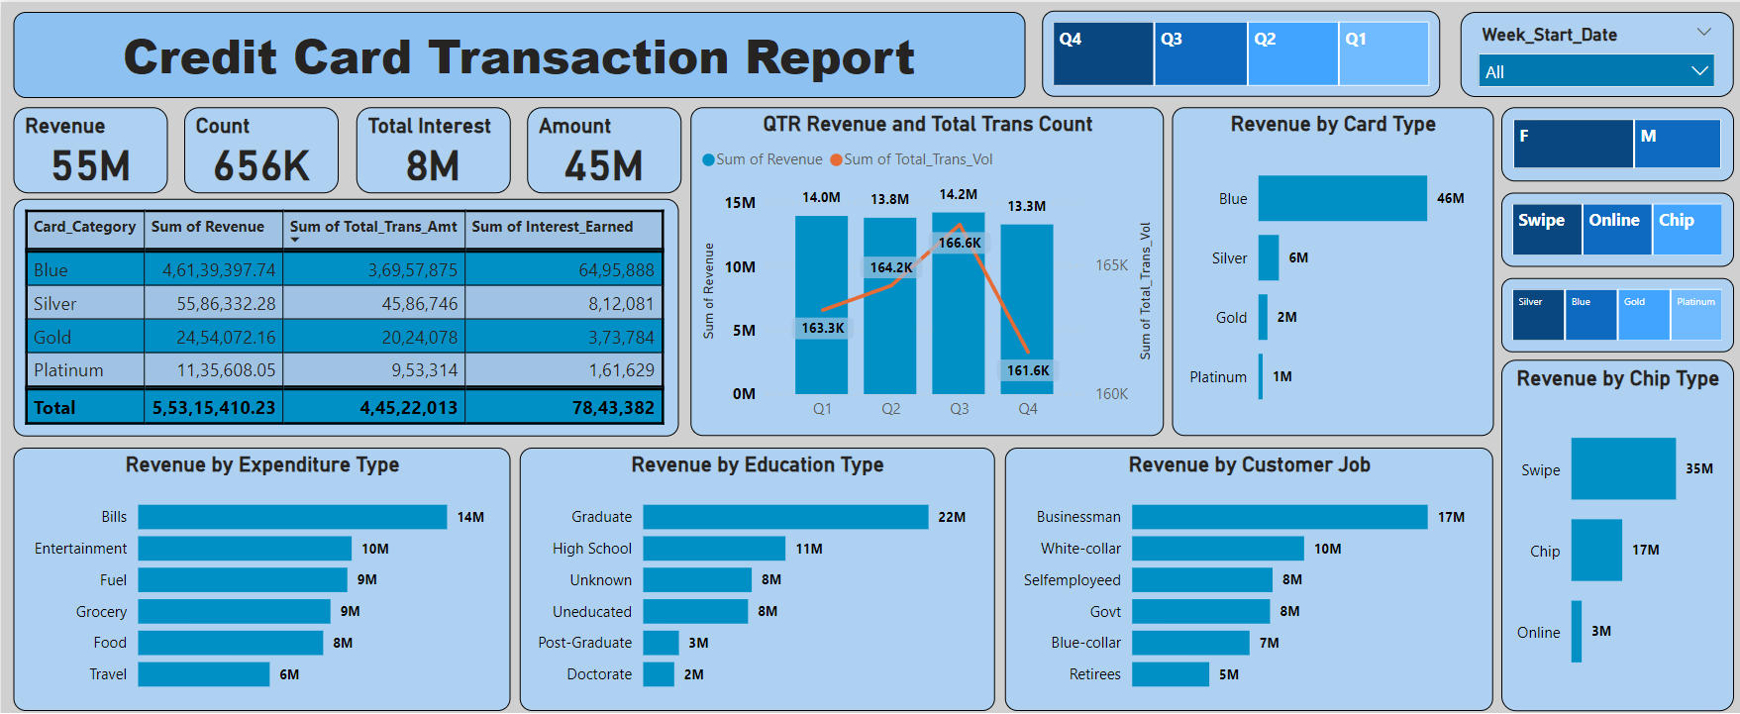
Credit Card Transaction Financial Dashboard

Slide 12
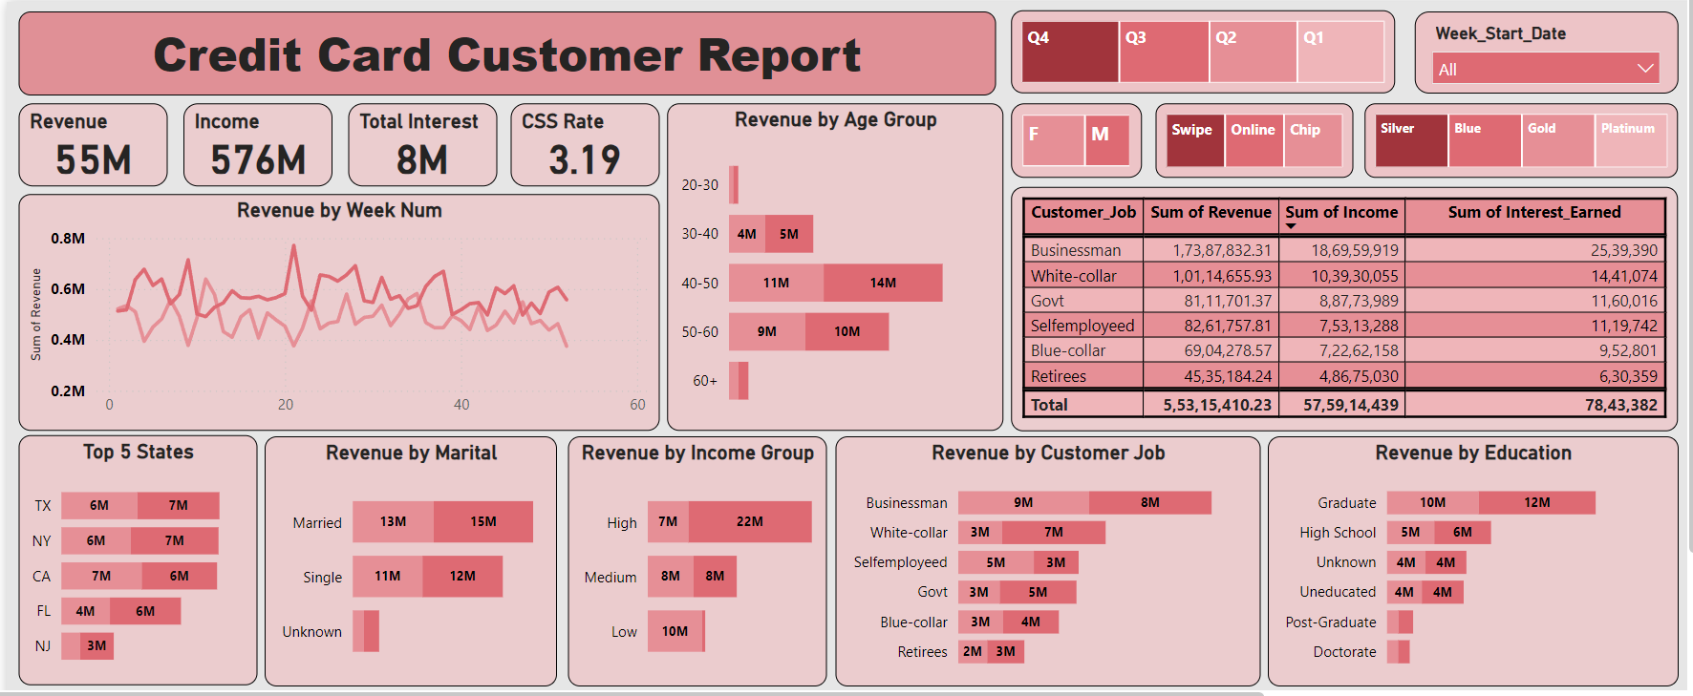
Credit Card Customer Financial Dashboard

Slide 13
Project Insights
WoW change:
Revenue increased by 28.8%,
Total Transaction Amt & Count increased by xx% & xx%
Customer count increased by xx%
Overview YTD:
Overall revenue is 55M
Total interest is 8M
Total transaction amount is 45M
Male customers are contributing more in revenue 30M, female 25M
Blue & Silver credit card are contributing to 93% of overall transactions
TX, NY & CA is contributing to 68%
Overall Activation rate is 57.5
Overall Delinquent rate is 6.06%

Slide 14
For follow more Details
Linkedin : www.linkedin.com/in/gangadharpappaka
Portfolio : https://gangadharpappaka9.github.io/gangadharpappaka

Slide 15


